Slide 1

COLLEGE OF ENGINEERING DEPARTMENT OF SOFTWARE ENGINEERING INTRODUCTION TO MACHINE LEARNING (SWEG4112)
Name:
Selahadin Desalegn
Natnahom Asfaw
Nebyu Daniel
Nebiyu Ermiyas
Abenezer Yonathan
Presentedd to: Mr. Kassahun
Date: 04/01/2026

Slide 2

LR (O) Parser
Interactive parsing with visualization
COMPILER CONSTRUCTION TOOL
Interactive Learning Platform for Parsing Theory
Features:
-

Slide 3

Overview
Features:
Complete LR(0) parser implementation
- Parse tree generation and visualization
- Interactive grammar input
- Conflict detection and analysis

Slide 4

What is LR(O) Parsing?
LR Parser Family
Left-to-right scan
Rightmost derivation in reverse
0 zero lookahead symbols
Key Characteristics:
Bottom-up parsing technique
Most powerful deterministic parser
Recognizes deterministic context-free languages
Basis for SLR, LALR, LR(1) parsers
LR(0) Automaton:
Collection of LR(0) items
States connected via goto transitions
ACTION and GOTO tables guide parsing decisions

Slide 5
Key Algorithms Implemented
1. Closure Computation
2. Goto Function
- Computes state transitions
- Moves dot position
- Applies closure
def closure(items, G, nonterminals):
I = set(items)
while changed:
for (lhs, rhs, dot) in I:
if dot < len(rhs) and rhs[dot] in nonterminals:
add productions starting with X
return frozenset(I)
3. Canonical Collection
- Builds all LR(0) states
- Creates finite automaton
4. Table Construction
- ACTION: shift/reduce decisions
- GOTO: state transitions on non-terminals

Slide 6
Interactive Grammar Input
1. User-Friendly Interface:
Features:
- Automatic augmentation with S'
- Symbol validation
- Multi-RHS support with '|'
- Epsilon production handling
- Interactive error correction
Enter terminals (comma-separated): id, +, *, (, )
Enter non-terminals: E, T, F
Enter start symbol: E
Enter productions:
> E -> E + T | T
> T -> T * F | F
> F -> ( E ) | id
> done

Slide 7
Parse Tree Construction
1. During Parsing
2, Tree Node Structure
class ParseTreeNode:
def __init__(self, symbol, children, is_terminal):
self.symbol = symbol # Grammar symbol
self.children = children # Child nodes
self.is_terminal = is_terminal
self.parent = None
Stack Operations → Tree Construction
─────────────────────────────────────
Shift 'id' → Create terminal node
Reduce F → id → Create F node with id child
Reduce T → F → Create T node with F child
...
Accept → Complete tree with root S'
Build Process:
1. Push terminals during shift
2. Pop children during reduce
3. Create parent node
4. Re-push parent to stack

Slide 8
ASCII Tree Visualization
Console Output Example:
Features:
- Unicode characters for clean display
- Terminal/non-terminal identification
- Hierarchical structure clearly shown
- No external dependencies needed
PARSE TREE (ASCII Console View)
========================================
E' (NT)
└── E (NT)
├── E (NT)
│ └── T (NT)
│ └── F (NT)
│ └── id (T)
├── + (T)
└── T (NT)
├── T (NT)
│ └── F (NT)
│ └── id (T)
├── * (T)
└── F (NT)
└── id (T)

Slide 9
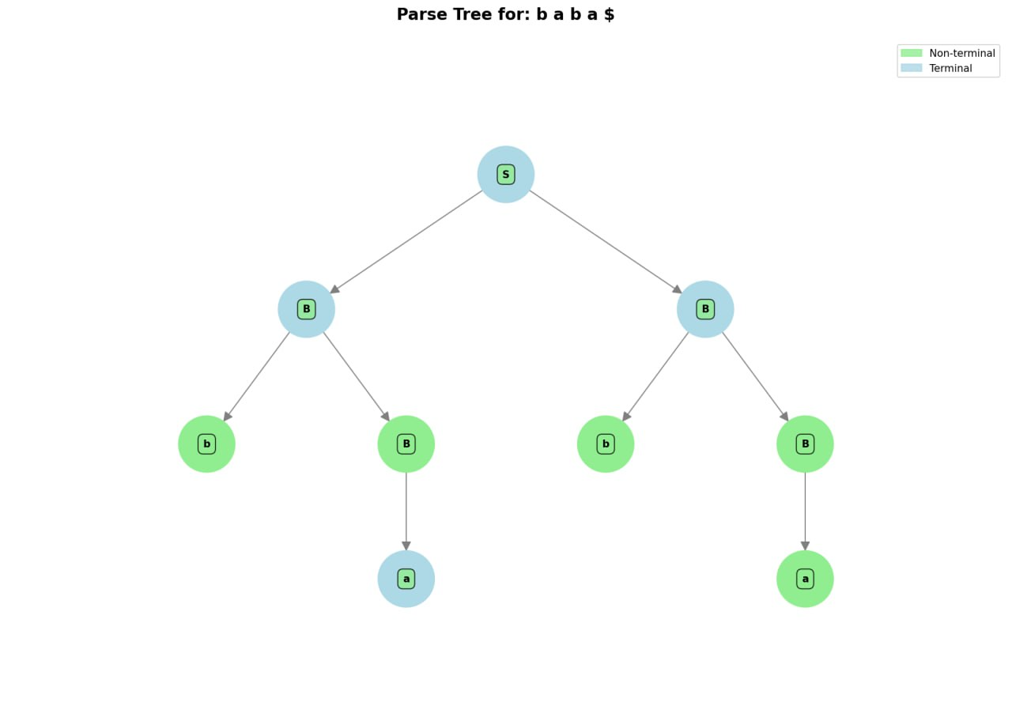
Graphical Tree Visualization
Parse Tree Example
Visual Elements:
- Green nodes: Non-terminals
- Blue nodes: Terminals
- Directed edges: Parent-child relationships
- Automatic layout: Hierarchical tree arrangement
Technical Implementation:
- Uses NetworkX for graph structure
- Matplotlib for rendering
- Automatic positioning algorithm
- Export as high-resolution PNG

Slide 10
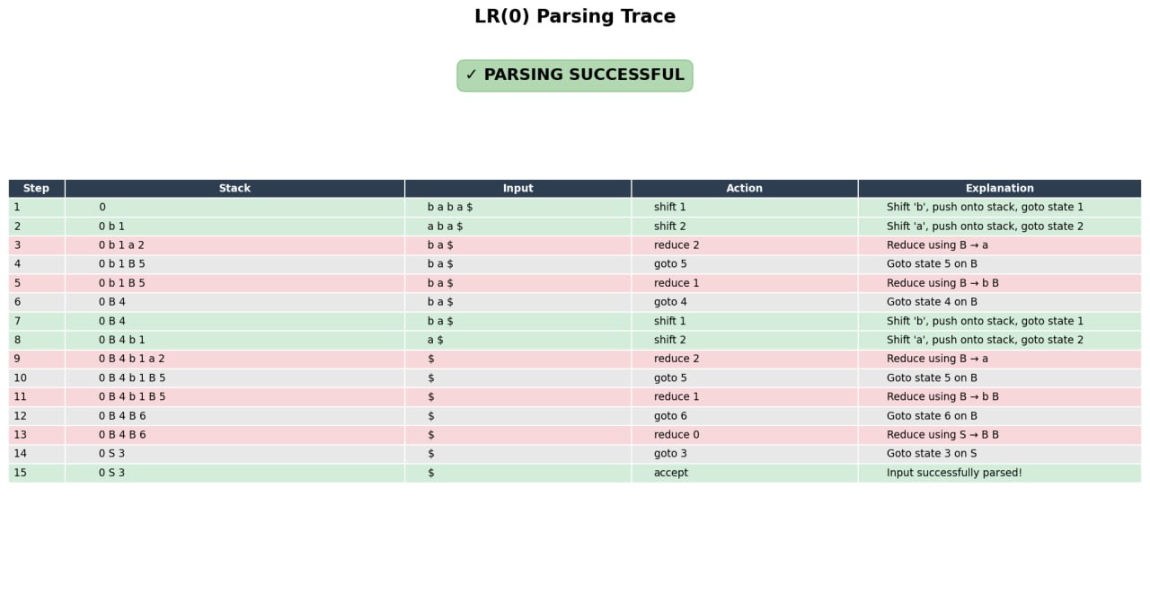
Parsing Trace Table
Educational Value:
- Visualizes parser internals
- Shows stack evolution
- Illustrates conflict resolution
- Debugging aid for grammar design
Interactive Step-by-Step View:

Slide 11
Conflict Detection
Types of Conflicts:
1. Shift/Reduce Conflict
- Parser cannot decide between shift and reduce
2. Reduce/Reduce Conflict
- Multiple reductions possible
Automatic Detection:
if a in ACTION[i]:
if ACTION[i][a][0] == "shift":
conflicts.append(f"Shift/reduce conflict on {a}")
elif ACTION[i][a][0] == "reduce":
conflicts.append(f"Reduce/reduce conflict on {a}")

Slide 12
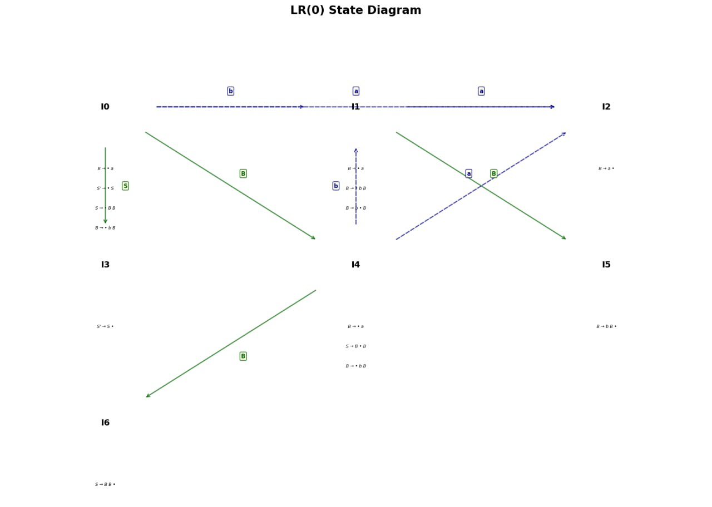
Example:

Slide 13
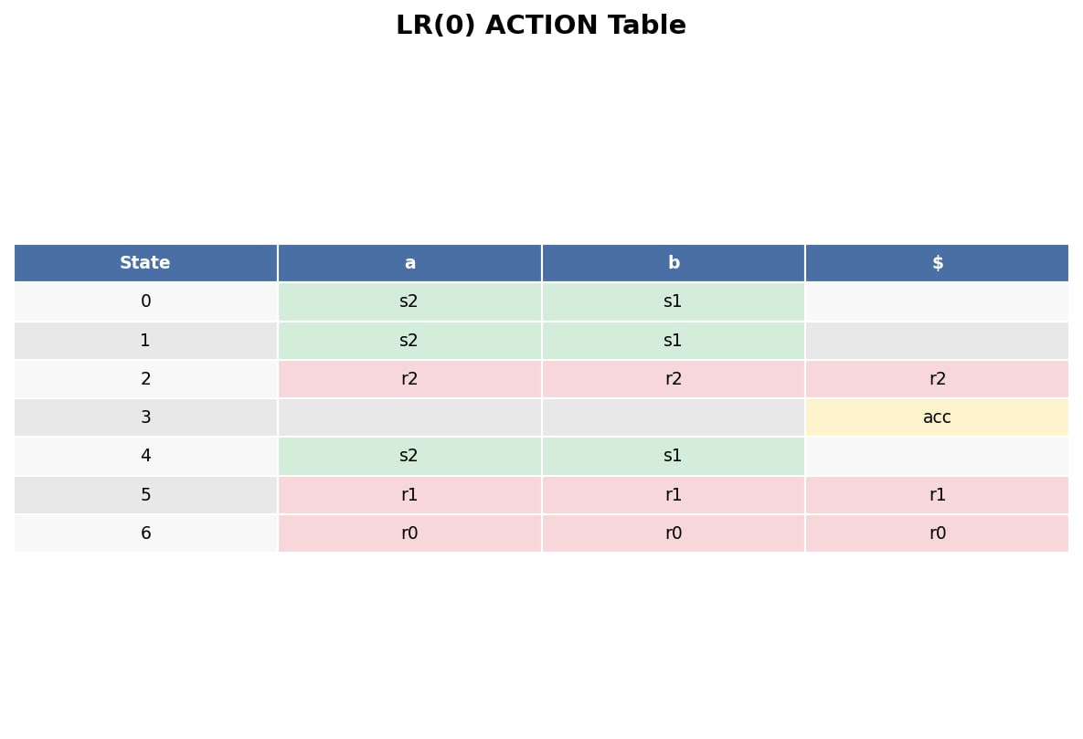
Example:

Slide 14
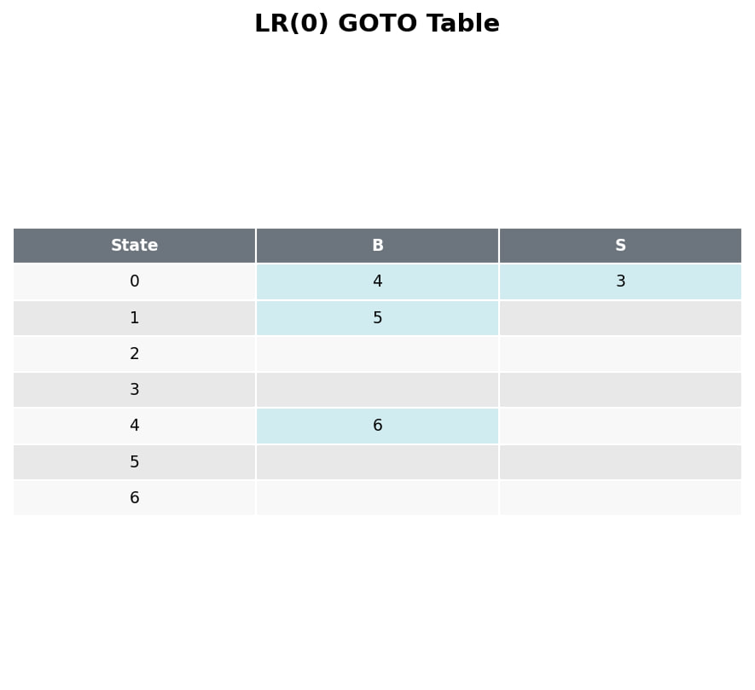
Example:

Slide 15
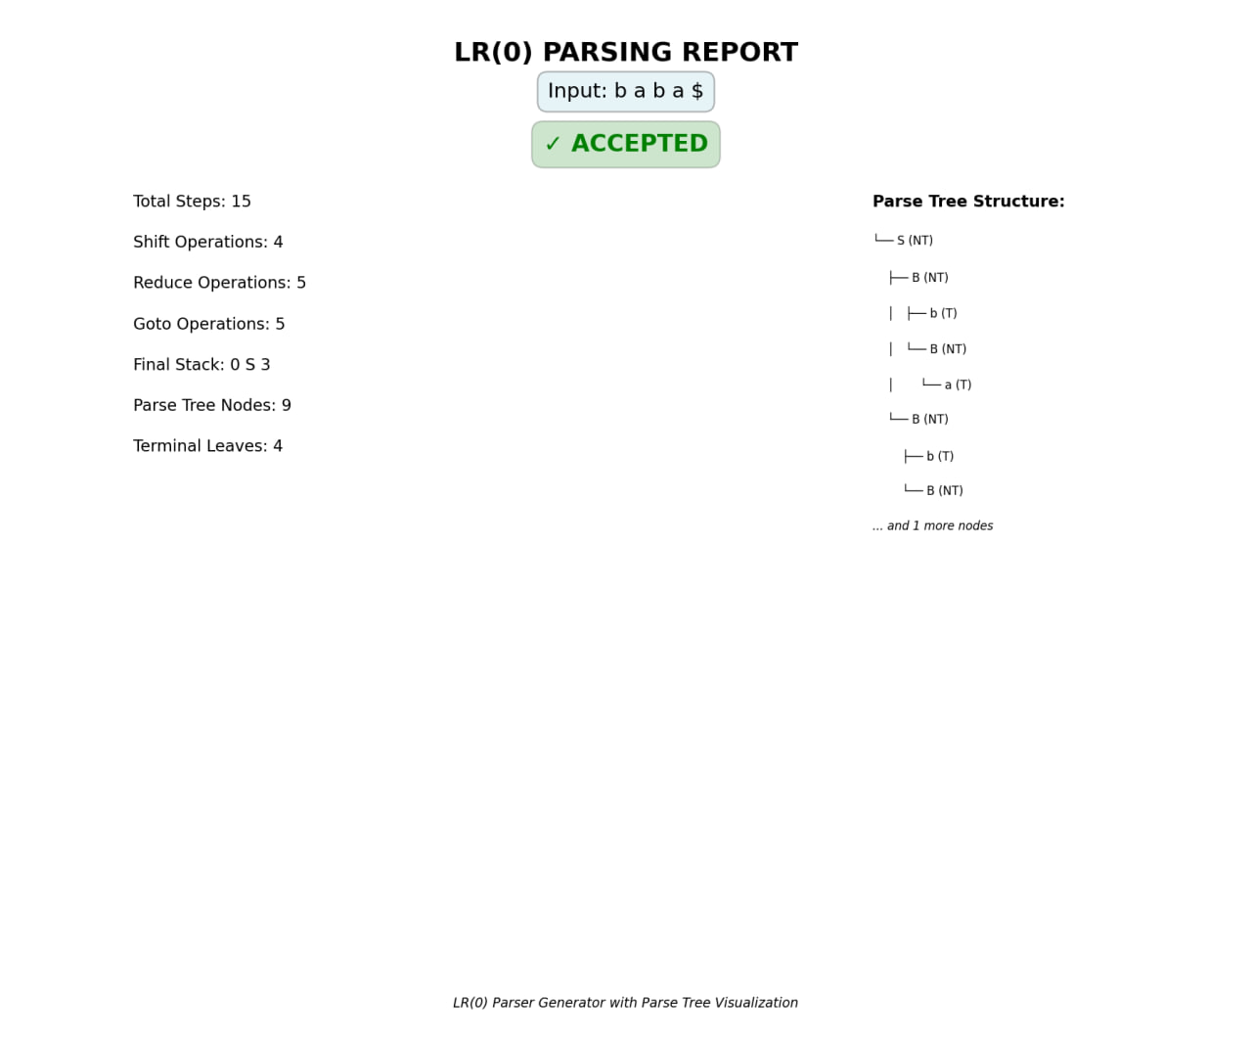
Example:

Slide 16
Example:

Slide 17
Example:

